Slide 2
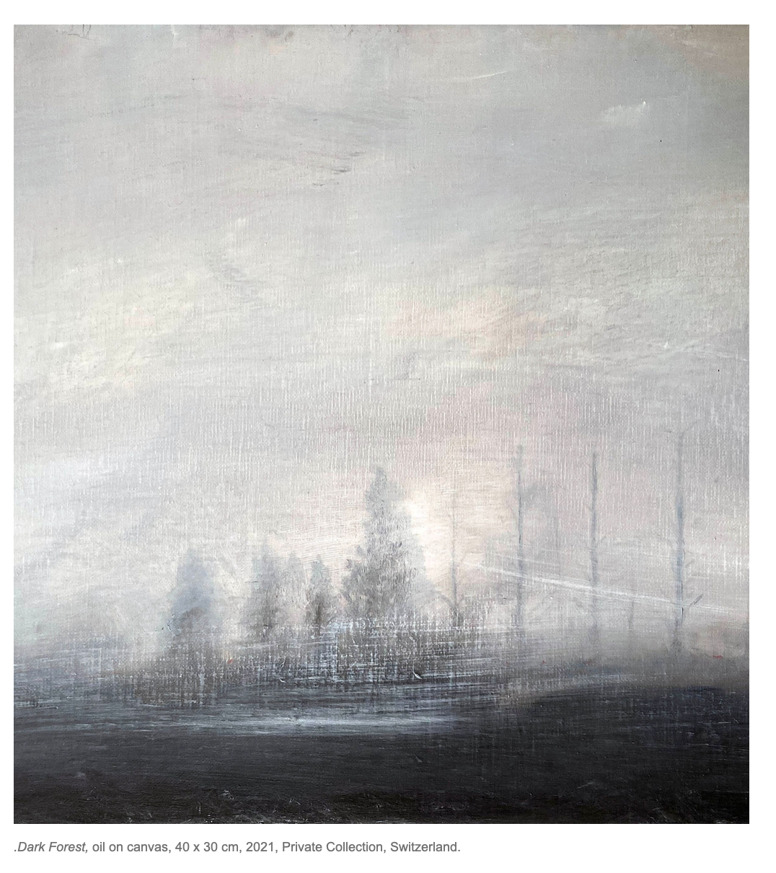
Artist: Pascal Ungerer
Check out the work on his website:
What kind of things does he paint?
____________________________
What word would you use to describe his paintings?
______________________________

Slide 3
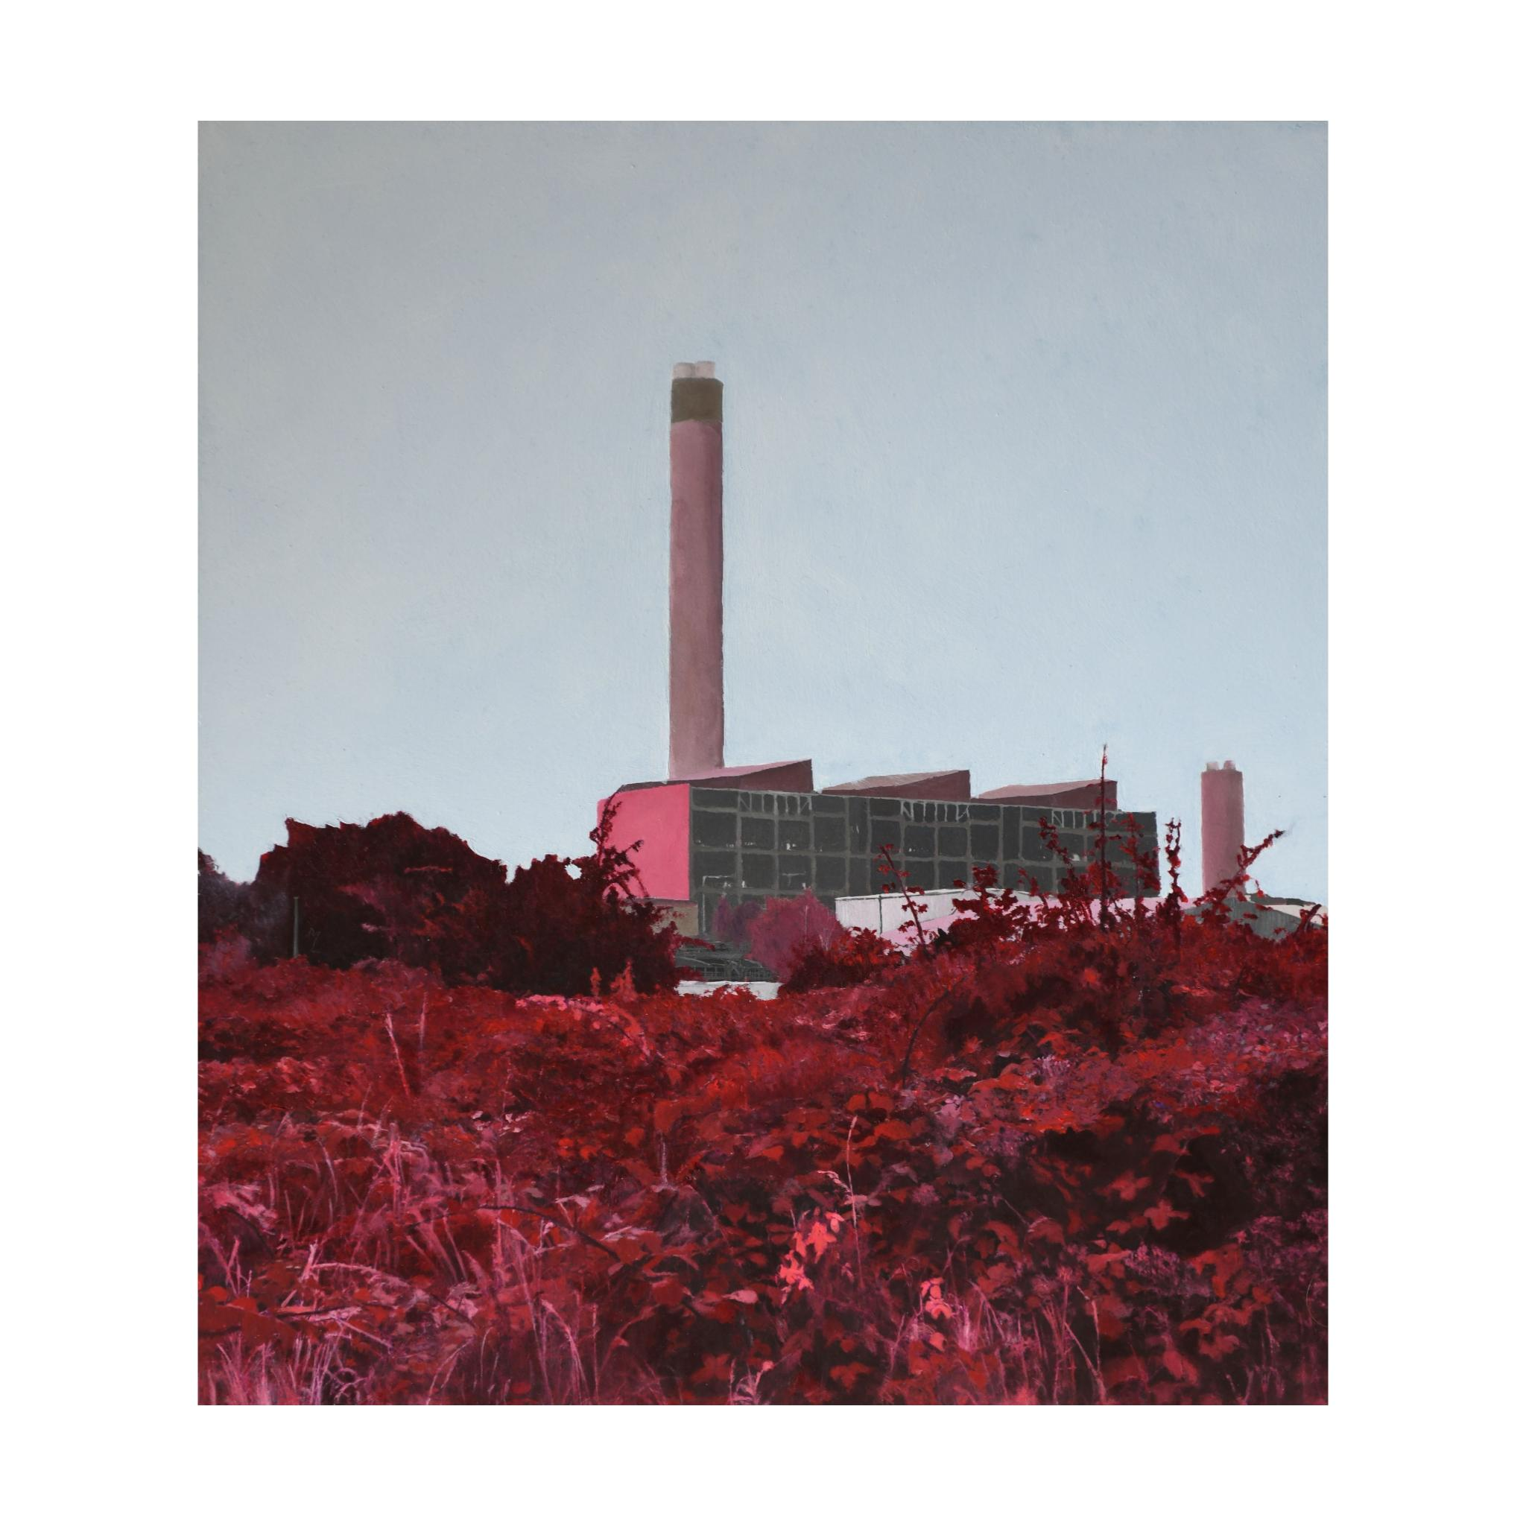
In between places
Between Urban and rural
Fictional landscapes, dreamlike

Slide 4
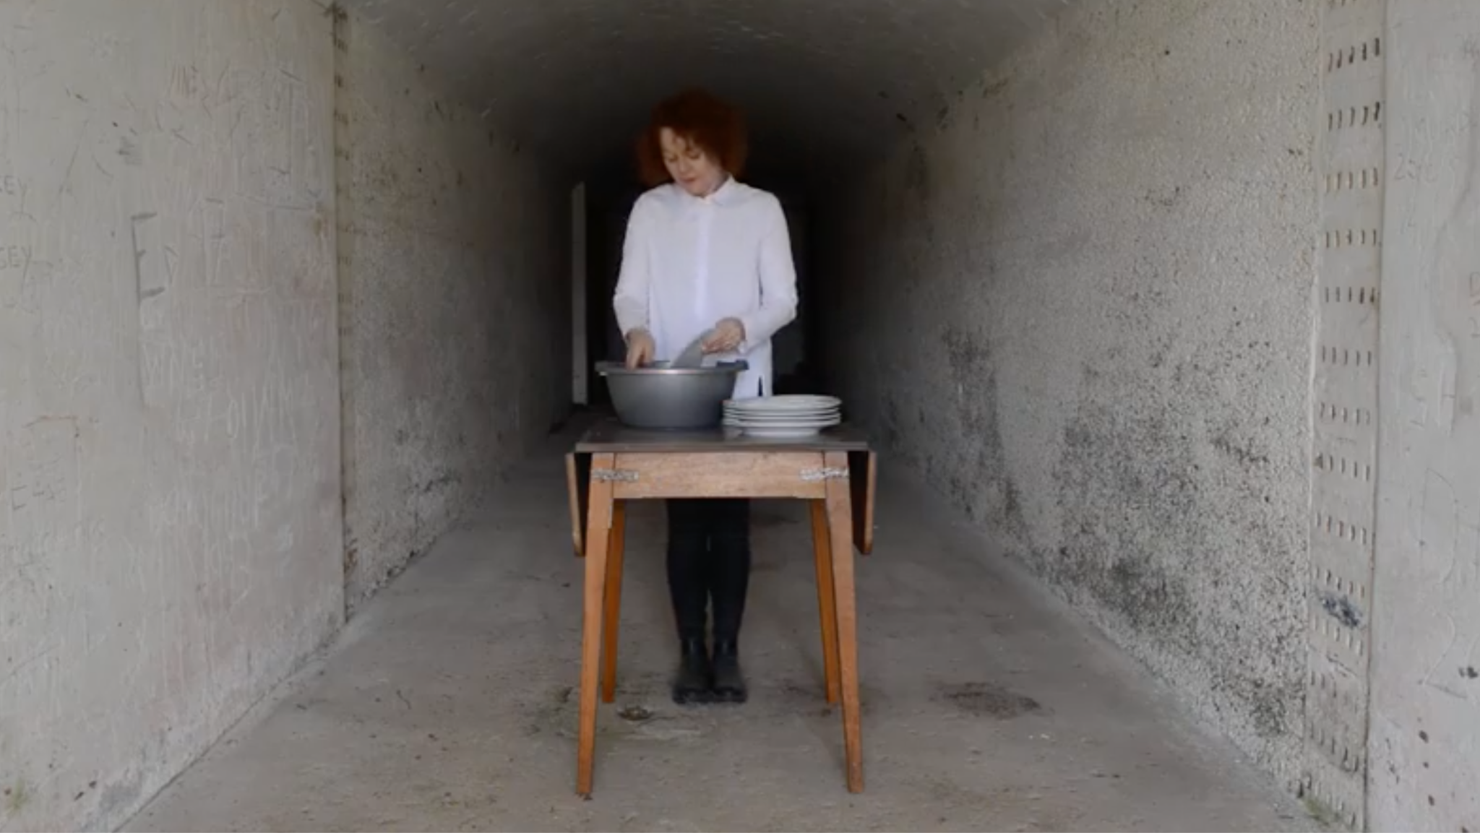
Mary Sullivan
Where is Mary from?
_____________________________
What kind of themes does she deal with?
___________________________________
Check out the work on her website:
‘At home, at war’, video still, Bere Island

Slide 5
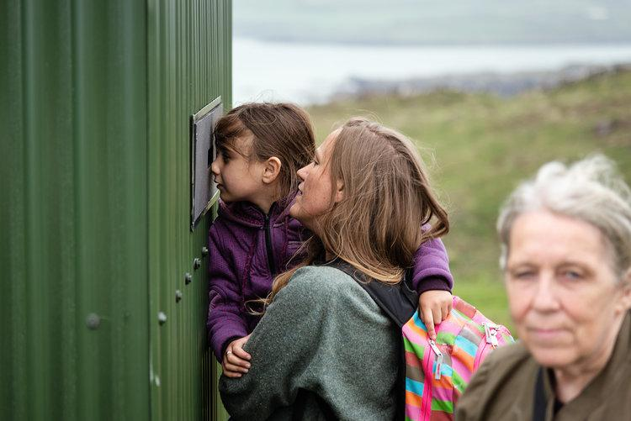
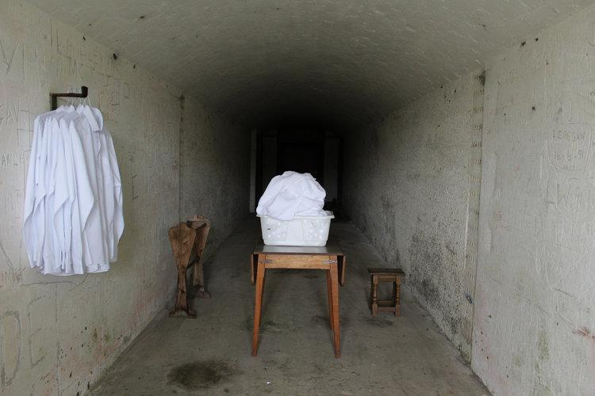
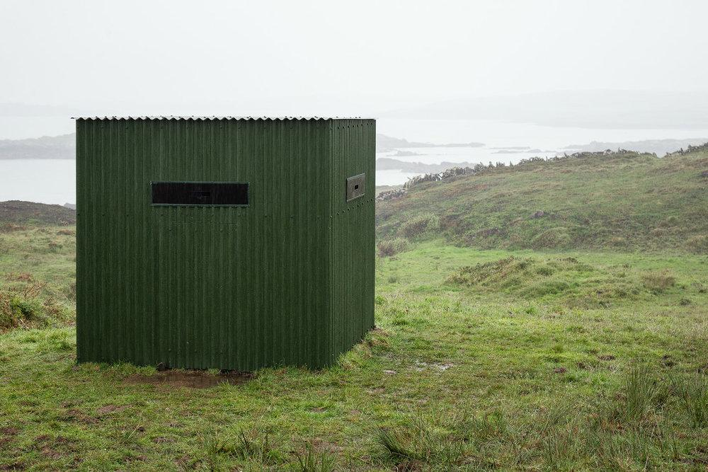
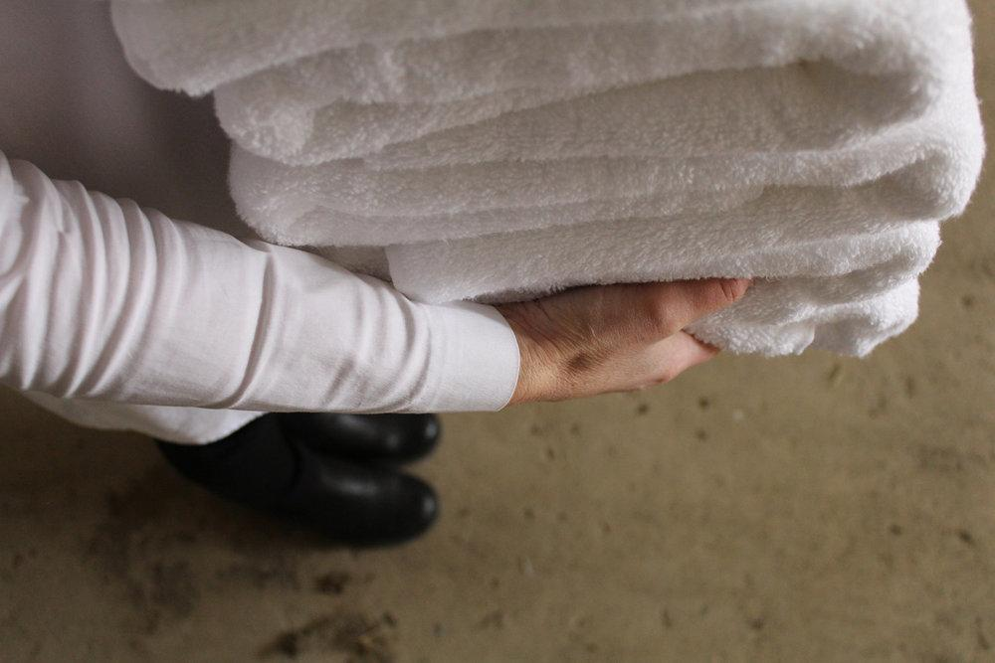
At home, at war, Mary Sullivan, Bere Island

Slide 6
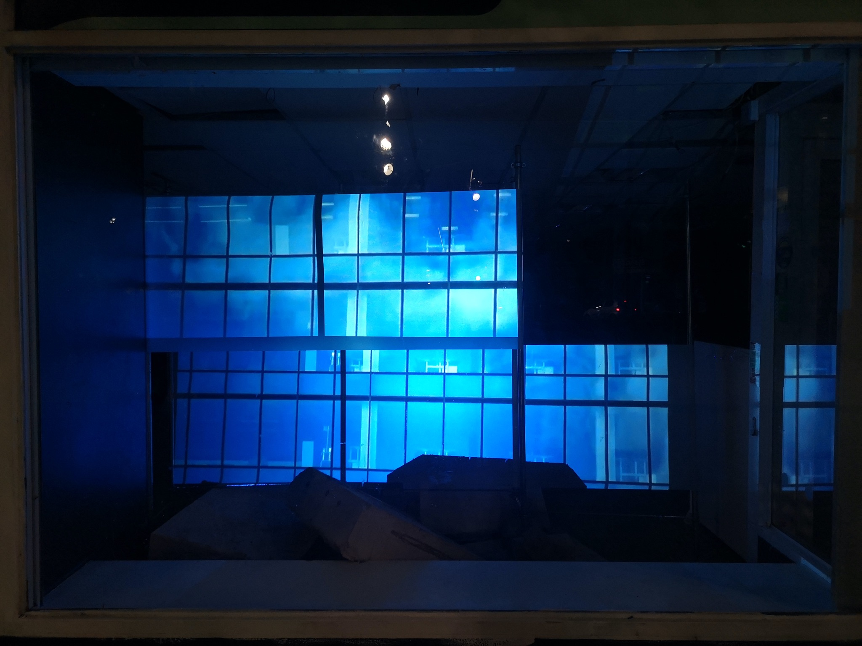
Kate McElroy
Check out the work on her website:
Name two words to describe Kate’s work?
_____________________________
What kind of places do you see in her work?
_____________________________

Slide 7
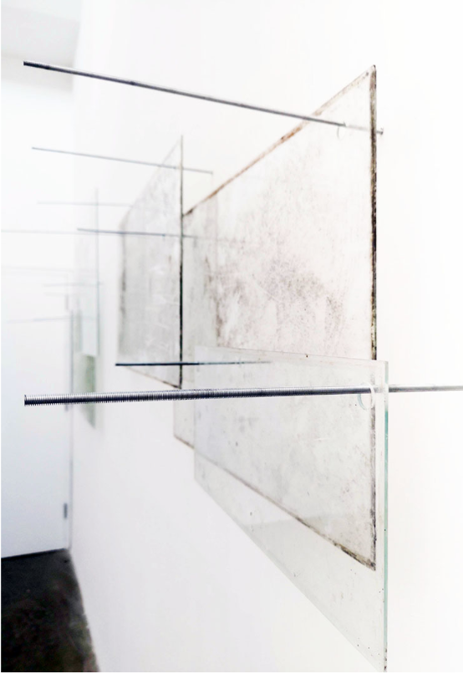
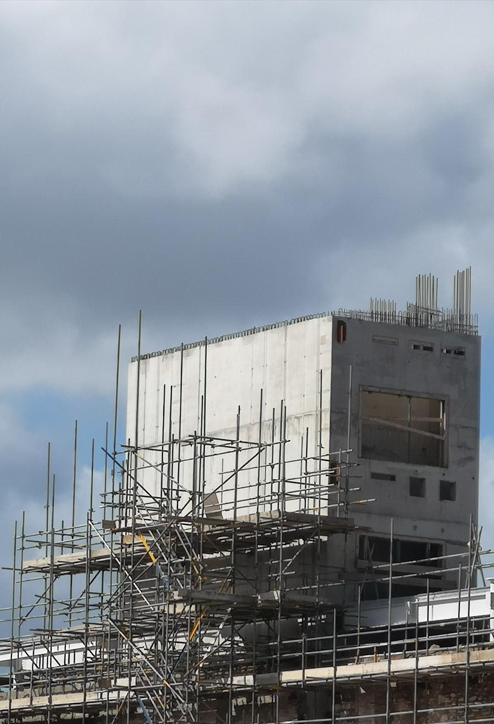
Glass installation at Uillinn:WCAC, 2020
Reference image

Slide 8
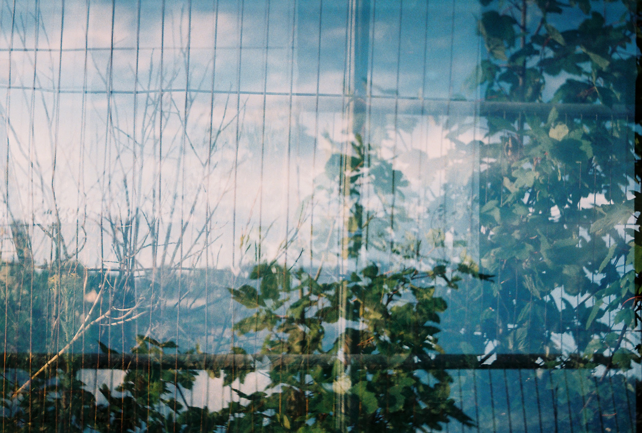
Photography work

Slide 9
Doing Art allows you to represent ideas in a way that makes sense to you and hopefully makes sense to other people too
- Mary Sullivan

Slide 10
What different ways could you represent this through Art?
B
R
A
I
N
S
T
O
R
M

